Slide 1


Exploring Sampling Techniques to Reduce Respondent Burden Wei, Yijun(Frank) USDA-NASS Yijun.Wei@nass.usda.gov Bejleri, Valbona USDA-NASS Valbona.Bejleri@nass.usda.gov
Notes:
Hello everyone, my name is Yijun Wei and I would like to acknowledge my co-auther Valbona Bejleri

Slide 2
Outline
Purpose of research
Sampling procedures
Coordination function
Three simulation studies
The results of simulations
Some concluding remarks
Notes:
I will briefly describe the purpose of research, sampling procedures used for our simulation studies and the proposed coordination function approach. Following with the design and results of three simulation studies, and some concluding remarks.

Slide 3
National Agricultural Statistics Service (NASS)
Agricultural Estimates
Conducts more than 100 surveys annually
Produces more than 400 reports
Publishes 7 federal principal economic indicators
Provide information for the commodity markets
Tight timelines
Samples are drawn prior to start of growing season
Desire to spread the response burden to the extent possible
Very large farms must be included in sample to get precise estimates
Potential to spread among other farms
Notes:
NASS conducts more than 100 surveys, 400 reports, and 7 federal principal economic indicators each year. Samples are drawn prior to start of growing season. NASS would like to spread the response burden to the extent possible, that is the origination of this study.

Slide 4
Purpose of Research
Exploring for a sampling design that will allow:
Optimal coordination of surveys
Small respondent burden (small number of appearances of an operation across sample surveys)
Efficient estimators
Consistent
Unbiased
Efficient with respect to the variance
Fixed sample size
Simple implementation
Notes:
The purpose of the research is to explore a sampling design that will allow for Optimal coordination of surveys, Efficient estimators, Fixed sample size, Simple implementation

Slide 5
Sequential Interval Poisson Sampling (SIP) at NASS
Employed in Agricultural Resource Management Survey (ARMS)
Controlling overlap between ARMS from previous year and Crop APS sample for the current year
Poisson sampling is used with Probability Proportional to Size (PPS) scheme (Ohlsson, 1992)
Poisson sampling yields fixed sampling fraction but not a fixed sample size
Each element of population may have different probability of being included in the sample
Notes:
Sequential Interval Poisson Sampling (SIP) is widely used especially in Agricultural Resource Management Survey to control the respondent burden, i.e. overlap, between ARMS from previous year and Crop APS sample for the current year. In Sip, Poisson sampling is used with Probability Proportional to Size (PPS) scheme . Poisson sampling yields fixed sampling fraction but not a fixed sample size
which implies samples selected by SIP do not have fixed size but a fixed sampling ratio. Also each element has different probability of being included in the sample.

Slide 6
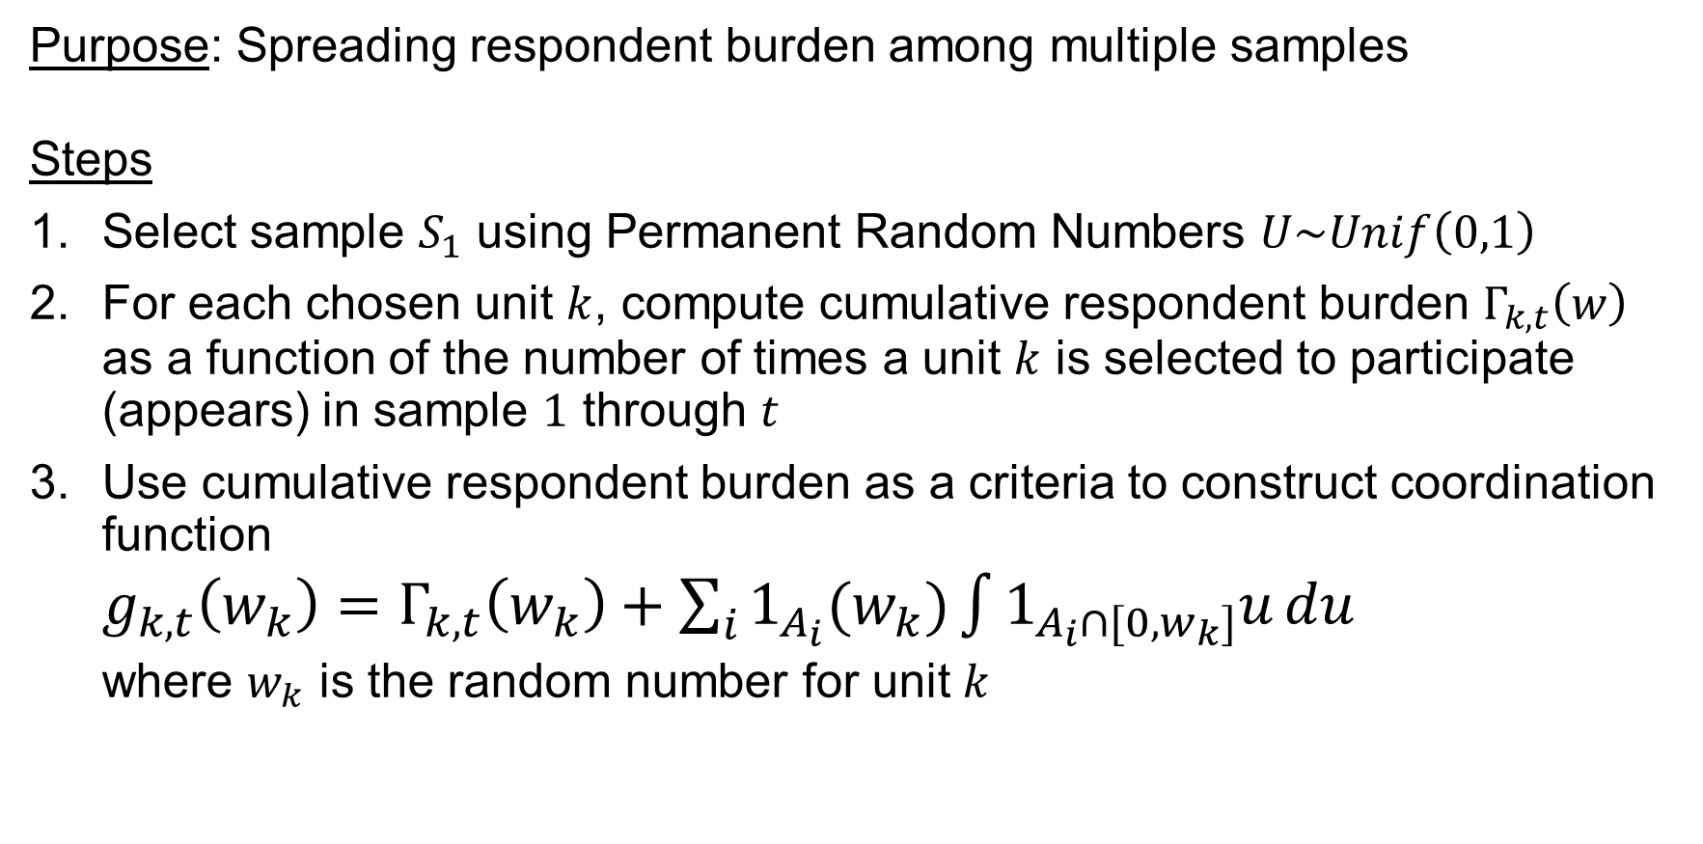
Coordination Function
Purpose: Spreading respondent burden among multiple samples
Steps
Select sample $S_{1}$ using Permanent Random Numbers $U\sim Unif\left(0,1\right)$
For each chosen unit $k$, compute cumulative respondent burden $Γ_{k,t}\left(w\right)$ as a function of the number of times a unit $k$ is selected to participate (appears) in sample $1$ through $t$
Use cumulative respondent burden as a criteria to construct coordination function
$g_{k,t}\left(w_{k}\right)=Γ_{k,t}\left(w_{k}\right)+\sum_{i}{1_{A_{i}}(w_{k})\int{1_{A_{i}∩[0,w_{k}]}u}du}$
where $w_{k}$ is the random number for unit $k$
Notes:
coordination function is used in this study to spread respondent burden among multiple samples. There are 6 step, first sample s1 is selected using Permanent Random Numbers (which is a random number drawn uniformly from (0,1 )). cumulative respondent burden $Γ_{k,t}\left(w\right)$ is computed for each chosen unit $k$ as a function of the number of times a unit $k$ is selected to participate (appears) in surveys $1$ through $t$. A coordination function $g_{k,t}\left(w_{k}\right)$ is constructed using cumulative respondent burden plus a term related to the random number. So the more frequent a unit is selected, the higher the respondent burden and the larger the current value of coordination function and less likely this unit will be selected again.

Slide 7

Coordination Function (Continued)
Steps
Update the random number for each unit to the current value of the coordination function $g_{k,t}\left(w_{k}\right)$
Select a unit based on its “new” updated random number
Repeat n times steps 1 – 5 to select samples $S_{1}$, $S_{2}$, …, $S_{n}$
Notes:
Then the random number $w_{k}$ for each unit is updated with the current value of the coordination function $g_{k,t}\left(w_{k}\right)$. Select a unit based on its “new” updated random number. Repeat n times steps 1 – 5 to select samples $S_{1}$, $S_{2}$, …, $S_{n}$.

Slide 8
Previous Studies
First study:
Simulated population of 100
Sampling rate is 25% for each of 10 samples
Coordination function led to reduced respondent burden compared to SRS, PPS, or a combination of SRS and PPS
Second study:
NASS Agricultural Yield Row Crops, Agricultural Yield Small Grains, and Crop APS Survey data
Sampling rate is about 10% for each of 3 samples
Coordination function led to marginal reduction in respondent burden compared to SIP
Notes:
Two previous preliminary studies have been done for coordination function, I am only going to give a brief review about them here. The first study tested coordination on a simulated population of 100, sampling rate is 25% for each of 10 samples, Coordination led to reduced respondent burden compared to SRS, PPS, or a combination of SRS and PPS
The second study tested coordination on NASS Agricultural Yield Row Crops, Agricultural Yield Small Grains, and Crop APS Survey data, (3 samples) sampling rate is about 10% for each sample, Coordination function led to marginal reduction in respondent burden compared to SIP
We have to notice that the difference between these two studies are the sampling rate, and that is why we have different conclusions.
To extend our research, we designed the third study, which is more comprehensive, we will discuss in next few slides.

Slide 9
Third Study
Simulated farm population: 100,000 farms
Farm simulated data
ID: farm number
Farm size (continuous) in acreage
Farm size category (12 categories)
Farm type: crop or livestock
Frequencies proportional to 2012 Census of Agriculture data frequencies
Stratification: Farm size category x Farm type
Acreage (continuous)
Random Uniform [min acreage, max acreage] within stratum (except for largest size category)
For largest size category: Allow for long-tail distribution of size
Notes:
In the third study, simulated farm population of 100,000 farms is created with 4 variables, farm id, continuous farm size, categorical farm size, and farm type. The frequency of categorical farm size and farm type are proportional to 2012 Census of Agriculture data frequencies. continuous farm size for each farm is drawn random uniformly from [min acreage, max acreage] within first 11 size categories. For the largest size category, long-tail distribution is used to draw size for each unit.

Slide 10
Third Study
Nine survey sequences with varied sampling fractions
3 sampling schemes
No stratification
1-way stratification by Farm size (categorical)
2-way stratification by Farm size x Farm type
Sampling approaches to compare:
SIP
Coordination function
200 runs for each configuration
Units’ number of appearances in series of samples is reported
Notes:
There are nine surveys with varied sampling fractions that are drawn from the population for each of three sample designs, no stratification, 1-way stratification by farm size, and 2-way stratification by farm size and farm type. Sampling approaches are SIP and coordination function, 200 simulations are ran for each configuration

Slide 11
Table 3: Sampling rate (percentage of total population)
Sample | First Simulation | Second Simulation | Third Simulation | Fourth Simulation | Fifth Simulation | Sixth Simulation | Seventh Simulation | Eighth Simulation | Ninth Simulation
1st | 25 | 75 | 75 | 90 | 90 | 25 | 10 | 25 | 10
2nd | 25 | 25 | 25 | 25 | 25 | 25 | 10 | 25 | 10
3rd | 25 | 25 | 25 | 25 | 25 | 25 | 10 | 25 | 10
4th | 25 | 25 | 25 | 25 | 25 | 25 | 10 | 25 | 10
5th | 25 | 25 | 25 | 25 | 25 | 25 | 10 | 25 | 10
6th | 25 | 25 | 10 | 25 | 10 | 25 | 25 | 25 | 25
7th | 25 | 25 | 10 | 25 | 10 | 25 | 25 | 25 | 25
8th | 25 | 25 | 10 | 25 | 10 | 25 | 25 | 25 | 25
9th | 25 | 25 | 10 | 25 | 10 | 25 | 25 | 25 | 25
10th | 25 | 25 | 10 | 25 | 10 | 75 | 75 | 90 | 90
Notes:
10 samples are selected for each of nine simulations, sample size is varied for every simulation. In the first one, sample size is 25% of the population for each sample. In the second simulation, it is almost the same as the first one, except the sample size of first sample is 75% of the population. The sample size for samples in third simulation is almost the same as that of the second simulation, except for 6th to 10th sample has sample size of 10% of the population. The sample size for samples in fourth simulation is almost the same as that of the first simulation except that the sample size for the first sample is 90%. The sample size for samples in fifth simulation is almost the same as that of the third simulation except that the sample size for the first sample is 90%. The sample size of sixth to ninth simulation is the reverse of that of the second simulation to fifth simulation.
The reason why we design such structure is that we plan to compare the performance of coordination function and SIP in different schemes, for example, in simulation 1 how cf perform compared with SIP when all the samples are with a moderate sample size of 25% of the population. In simulation 2 and 4, how cf perform compared with SIP when there is a sample with larger sample size and the rest are the same and with the moderate sampling rate. In simulation 3 and 5, how cf perform compared with SIP when there are mixed samples with smaller size, moderate size and large size. And what is going on for the reverse order of 2nd to 5th simulations.

Slide 12
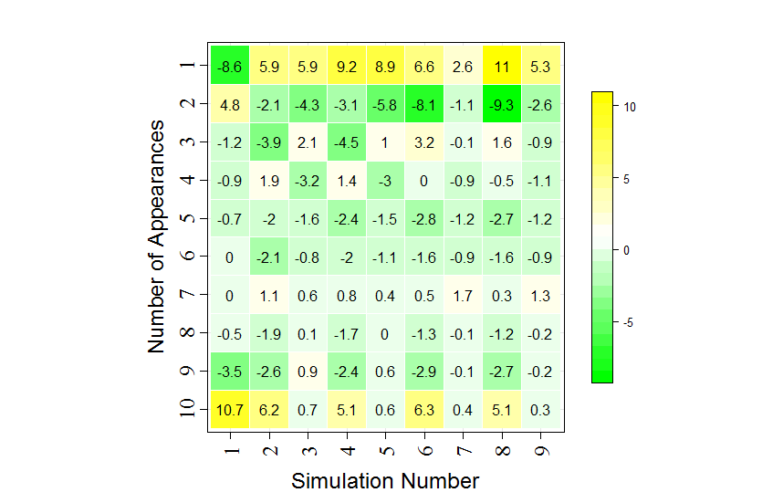
Difference of proportion (CF% – SIP%) using SIP and Coordination function. No stratification
Notes:
This graph displays the difference of proportion (percentage of using coordination function abstracting that of using SIP) in the no stratification situation. Yellow indicates that percentage of unites selected using coordination function is larger, green indicates that percentage of unites selected using SIP is larger. We can read from the graph that except for units that are selected for 10 times, using coordination function increase the number of units that have been selected for 1 or two times and decrease the number of units mostly that were selected for three times to nine times. However, when size category is not considered, there are some units with large size that have 1 as the probability of selection, which means that unit will be included in the sample for sure.
In this case, we do not want to use

Slide 13
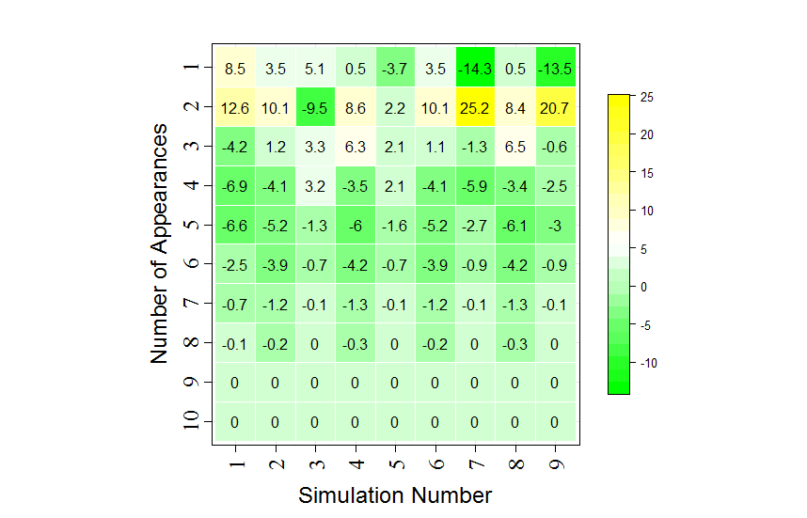
Difference of proportion (CF% – SIP%) using SIP and Coordination function. One way stratification by size
Notes:
This graph displays the difference of proportion (percentage of using coordination function abstracting that of using SIP) when one-way stratification by size is considered. As indicated in the previous slide, Yellow indicates that percentage of using coordination function is larger, green indicates that percentage of using SIP is larger. We can read from the graph that using coordination function increase the number of units that have been selected for 1 to three times and decrease the number of units mostly that were selected for more than three times except for third and fifth simulation, where the mixed sample design is used. However cf still descreases the number of units selected for more than 4 times.

Slide 14
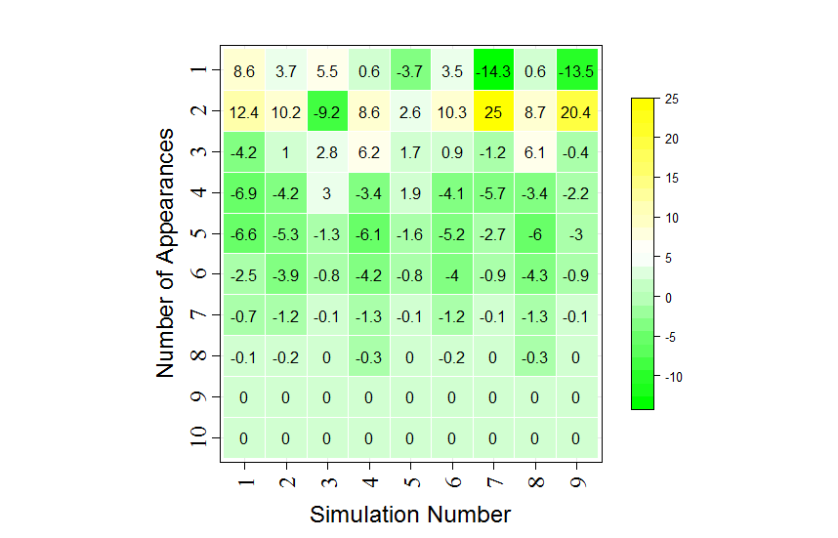
Difference of proportion (CF% – SIP%) using SIP and Coordination function. Two-way stratification by size and type

Slide 15
Summary
Third study
Sampling rate varies for 10 scenarios and for three different sampling schemes
With no stratification: Coordination function led to higher respondent burden compared to SIP
With 1-way and 2-ways stratification: Coordination function led to reduced respondent burden compared to SIP
As sampling rate increases, respondent burden over multiple samples increases
Coordination function is more effective at reducing respondent burden among stratified samples, as sampling rate increases
We have to think about when to use coordination function
This work is preliminary—more studies are needed

Slide 16
Acknowledgements
This work has been done under Strategic Optimization Sample Selection Team of Response Rate Research Team at USDA-NASS
Team members: Wendy Barboza, Franklin Duan, Jonathan Lisic, Brian Richards, Shareefah Williams, Valbona Bejleri, Yijun Wei
Nathan Cruze helped us with the graph

Slide 17
References
Berzofsky, M. E., Welch. B. L., Williams, R. L., and Biemer, P. 2008. Using a model-aided sampling paradigm instead of a traditional sampling paradigm in a nationally representative establishment survey. Research Triangle Park, NC: RTI Press.
Berzofsky, M. E., McRitchie, Brendle, M. B. (2012). Model-aided sampling: An empirical review. (2012). In proceedings of the Fourth International Conference on Establishment Surveys, 2012
Brewer, K. R. W., L. J. Early, and Muhammad Hanif. "Poisson, modified Poisson and collocated sampling." Journal of Statistical Planning and Inference 10.1 (1984): 15-30.
Deville, J.-C. (1991). A theory of quota surveys. Survey Methodology, 17, 163-181.
Ernst, L. R., and Casady, R. J.. (2000). Permanent and collocated random number sampling and the coverage of births and deaths. Journal of Official Statistics 16.3: 211
Guggemos, Fabien, and Olivier Sautory (2012). "Sampling coordination of business surveys conducted by Insee." In proceedings of the Fourth International Conference of Establishment Surveys.

Slide 18
References
King, B. (1985). Surveys combining probability and quota methods of sampling. Journal of the American Statistical Association, 80(392), 890-896.
Ohlsson, E. (1992). SAMU, The system for Co-ordination of Samples from the Business Register at Statistics Sweden. 18
Rosén, B. (1997). On sampling with probability proportional to size. Journal of Statistical Planning and Inference, 62(2), 159-191.
Sarndal, C., Swensson, B. and Wretman, J. (1992). Model Assisted Survey Sampling. Springer-Verlag
Smith, T. M. F. (1983). On the validity of inference from non-random samples. Journal of the Royal Statistical Society: Series A., Pt. 4, 146, 394-403
Stephenson, C. B. (1979). Probability sampling with quotas: An experiment. Public Opinion Quarterly, 43(4), 477-496.

Slide 19
Any Questions?
Thank you!

